Slide 1
PGRKAM Smart Assistant: An LLM-Powered Conversational Platform for Job Seekers
CSE7101- Capstone Project
Review-1
Batch Number: CAI_36
Under the Supervision of,
Mr. Jai Kumar B
Assistant Professor
School of Computer Science and Engineering
Presidency University
Roll Number | Student Name
20221CAI0042 | ASHWIN R
20221CAI0026 | SACHIN S
20221CAI0017 | HARSHIT B
Name of the Program: B.Tech CAI
Name of the HoD: Dr. Zafar Ali Khan N
Name of the Program Project Coordinator: Dr. Afroz Pasha
Name of the School Project Coordinators: Dr. Sampath A K , Dr. Geetha A

Slide 2
Problem Statement Number: PSCS_17
Organization: “Government of Punjab”
Category (Hardware / Software / Both) : “Software”
Problem Description: “The Employment Department at present has a digital platform www.pgrkam.com and its mobile application to provide almost all services offered to job seekers and employers through digital means. The portal has multiple modules like private sector jobs, government jobs, self-employment avenues, foreign jobs, foreign study, counseling, guidance, induction into armed forces, job melas, etc. Currently, when a user visits the portal/app, there is no hand-holding mechanism to help the user get to the part of the digital platform which will resolve his queries. The user is required to navigate across multiple modules on the portal/ app to search for answers.”

Slide 3
Content
Problem Statement
The current PGRKAM digital platform lacks an effective user guidance system, forcing users to manually navigate multiple modules to find information. This results in a poor user experience and inefficiency. The core problem is the absence of a "hand-holding mechanism" that can intelligently assist users, streamline the information discovery process, and reduce the time and effort required to find relevant details about jobs, skill development, or foreign counseling.
Objectives
Develop a smart chat-bot.
Enhance User Accessibility
Provide Personalized Assistance
Improve Information Retrieval

Slide 4
Content
Background and Related work for title Selection
The project's title, "PGRKAM Smart Assistant: An LLM-Powered Conversational Platform for Job Seekers," is derived from an analysis of existing and related technologies. It combines key aspects of the project: the platform name (PGRKAM), the core technology (LLM-Powered), and the purpose (Conversational Platform for Job Seekers).
Related Work:
Rule-Based Chatbots
AI Assistants (e.g., Siri, Alexa)
LLMs (e.g., GPT-3, GPT-4)

Slide 5
Analysis of Problem Statement
Technology Stack Components:
Front-End: React JS
Back-End: Flask/Django
Core-AI Engine: GPT-3
Database: MongoDB

Slide 6
Analysis of Problem Statement (contd...)
Software and Hardware Requirements:
Software: Python, JavaScript, a web framework (e.g., Flask), an LLM API, a database (e.g., MongoDB), and version control (e.g., Git).
Hardware: Standard development machines, and a cloud-based server with sufficient CPU and RAM for deployment.

Slide 7
Github Link
The Github link provided should have public access permission.
Github Link:
https://github.com/ashwin2947/PGRKAM-Smart-Assistant

Slide 8
Innovation & Novel Contributions
Domain-Specific LLM: It's a specialized chatbot tailored specifically for employment services.
Multilingual Support: The system handles text and voice queries in Punjabi, English, and Hindi, making it highly accessible.
Personalized Recommendations: It uses user history and preferences to provide personalized job suggestions.

Slide 9
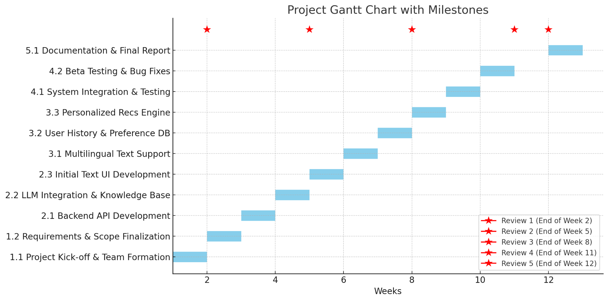
Timeline of the Project (Gantt Chart)

Slide 10
References (IEEE Paper format)
[1]. A. Vaswani et al., "Attention Is All You Need," in Advances in Neural Information Processing Systems, vol. 30, pp. 5998–6008, 2017.
[2]. S. F. Chen and G. D. Chen, "Smart Chatbot to Assist Users of Employment Websites in Job Search, Skill Development, and Networking Opportunities," in International Journal for Research in Applied Science & Engineering Technology, vol. 12, no. 4, Apr. 2024.
[3]. G. B. Satrya, P. T. Daely, and S. Y. Shin, “AI Based Multilingual College Enquiry Voice Bot Using Python,” ResearchGate, May 2024.
[4]. V. Sharma and P. K. Gupta, "Recommendation System using NLP and Collaborative Filtering," ResearchGate, May 2023.
[5]. G. K. Jain and P. Sravanthi, “Smart Career Advisor: A Machine Learning based Recommendation System,” in IEEE Xplore, Mar. 2024.

Slide 11


